Slide 1
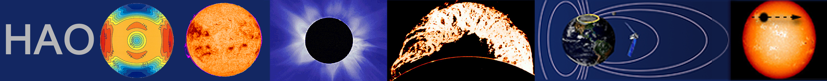

The restless interior of quiescent prominences*
B. C. Low**
High Altitude Observatory
National Center for Atmospheric Research
*Collaborators: Tom Berger (LMSAL), Roberto Casini (HA0), & Wei Liu (LMSAL & Stanford)
**HAO Seminar, June 13, 2012
The National Center for Atmospheric Research is operated by the University Corporation for Atmospheric Research
under sponsorship of the National Science Foundation. An Equal Opportunity/Affirmative Action Employer.

Slide 2
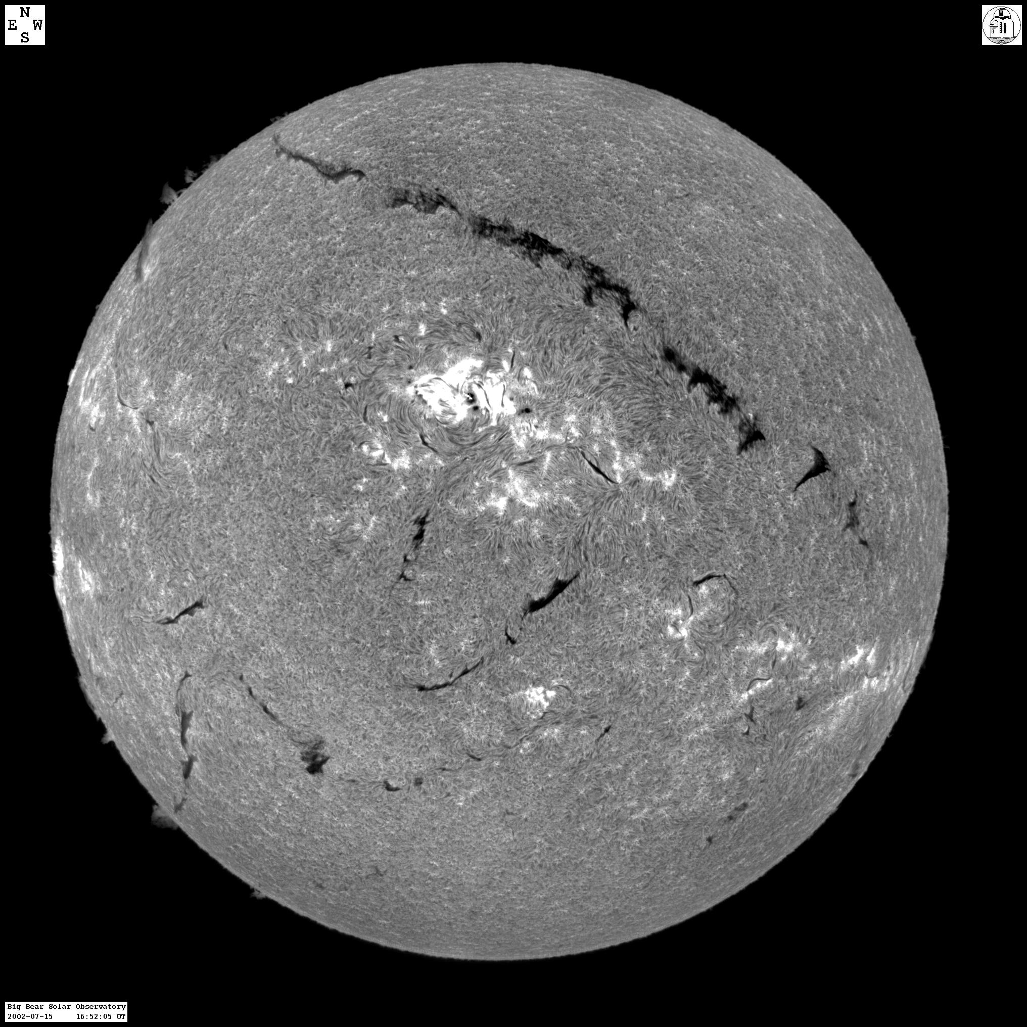

Slide 3
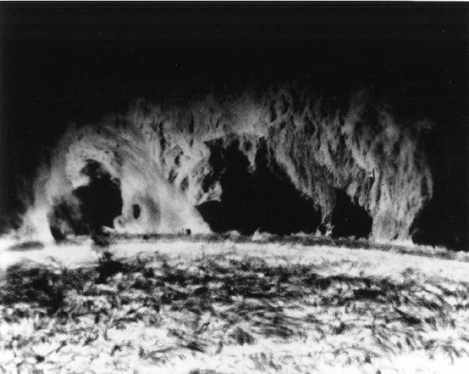
Quiescent prominence

Slide 4
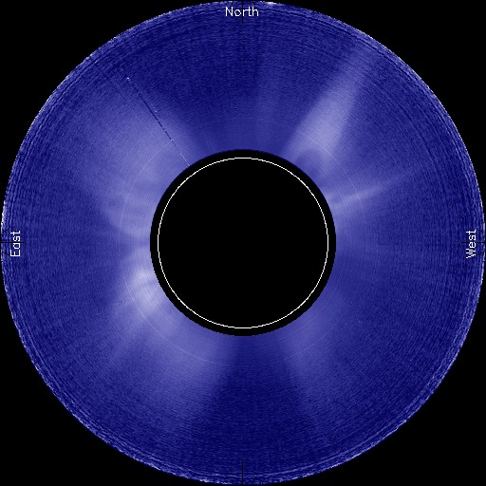
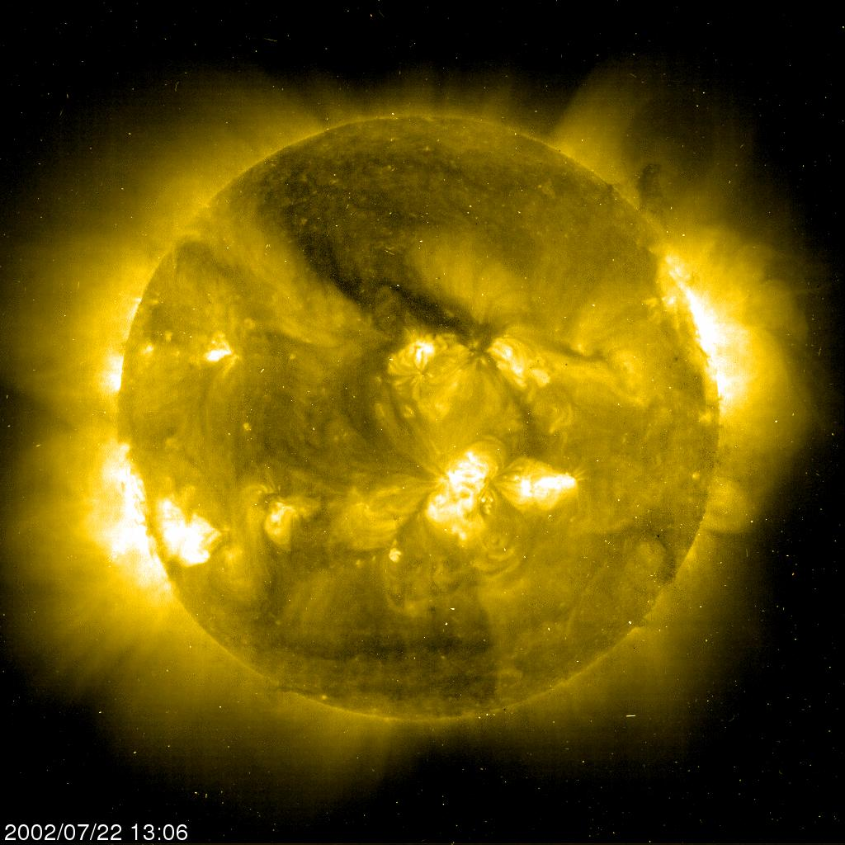
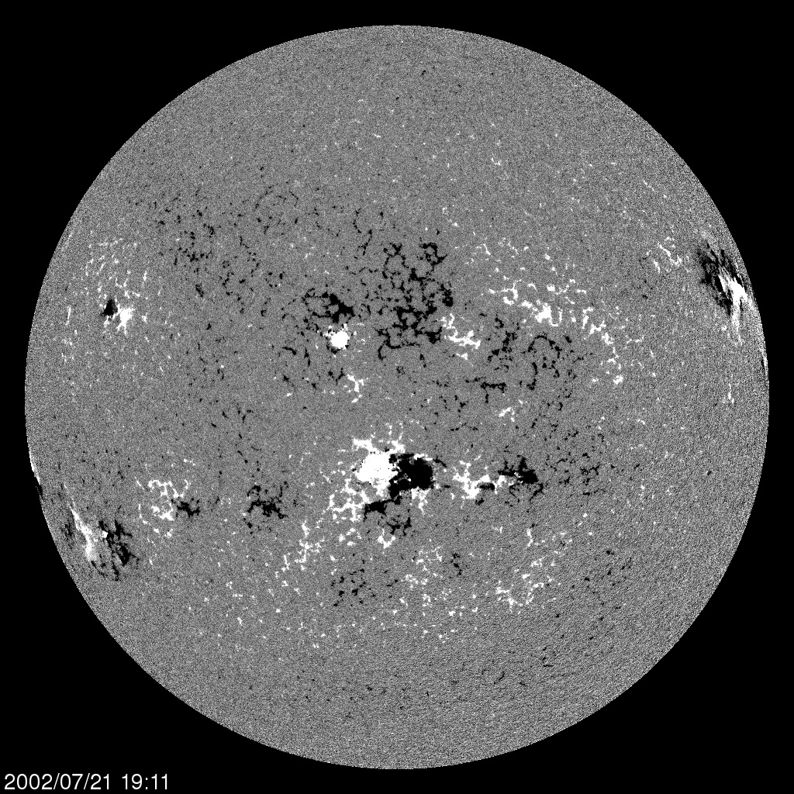
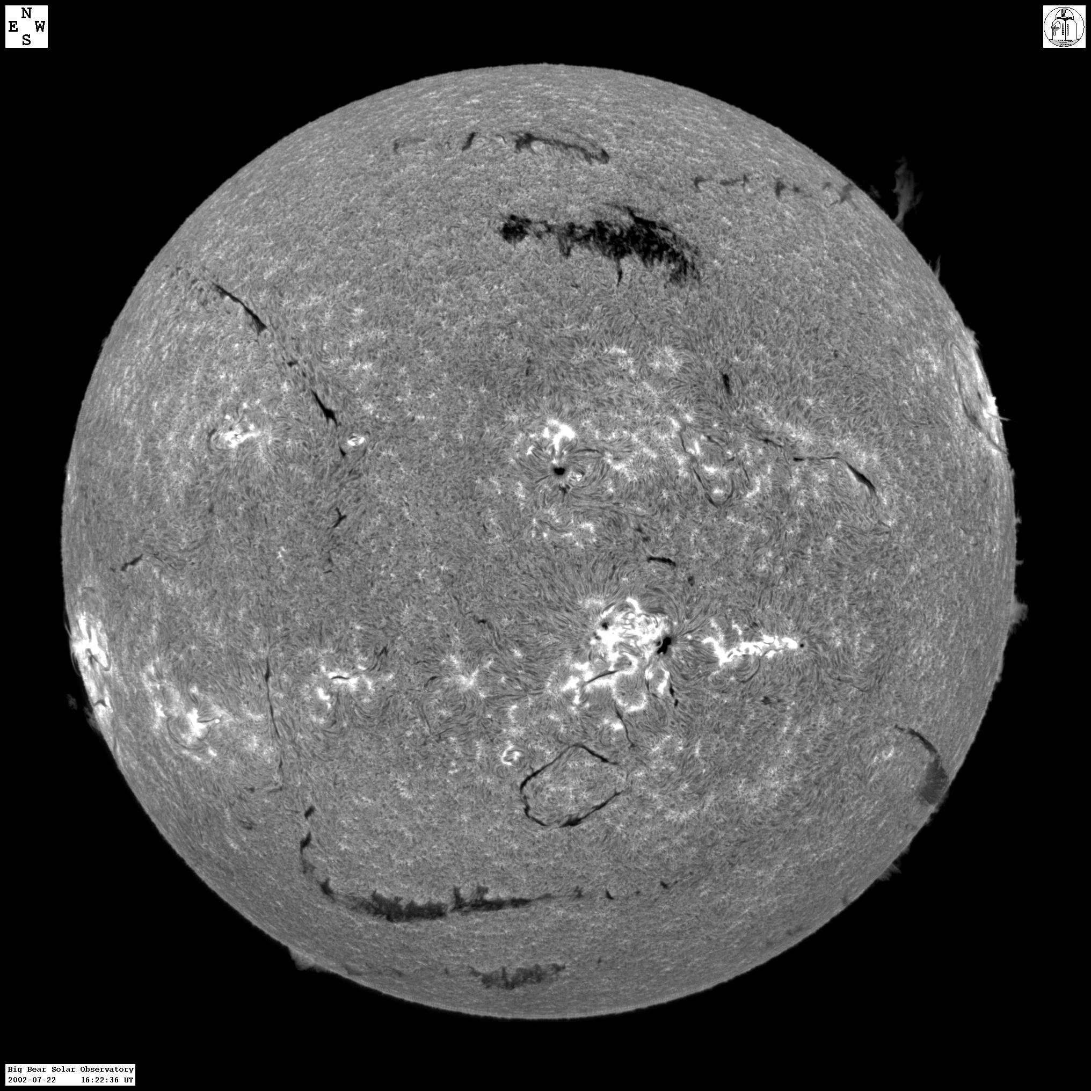
Figure 1. The crown prominence & coronal helmet of 2002/07/22
1b. EIT Fe XV 2002/07/22
1c. MDI 2002/07/21
1a. HAO/Mauna Loa white-light: helmet+cavity+prominence
1e. BBSO 2002/07/15
1d. BBSO 2002/07/22

Slide 5
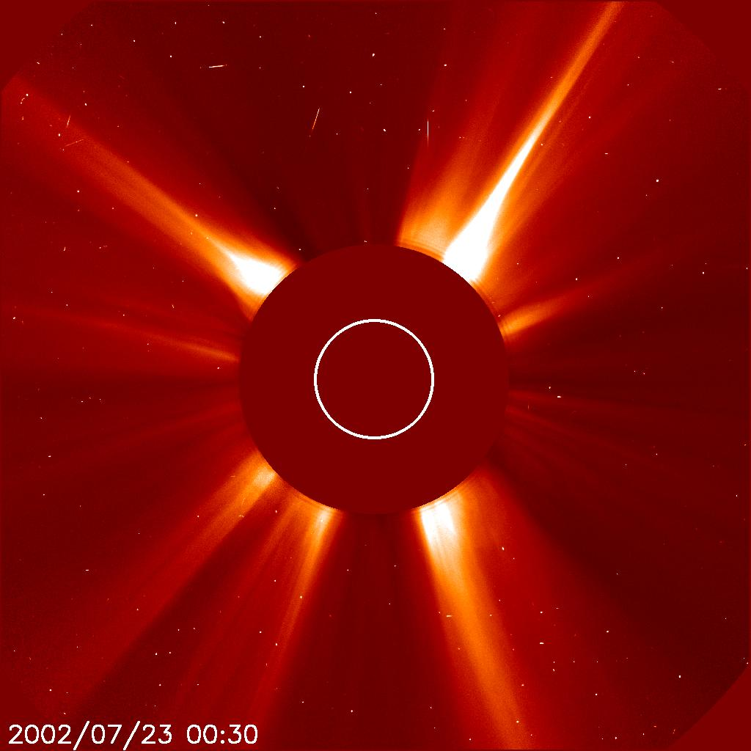
The bodily ejection of the 2002/07/22 helmet-streamer as a CME - SOHO/LASCO2

Slide 6
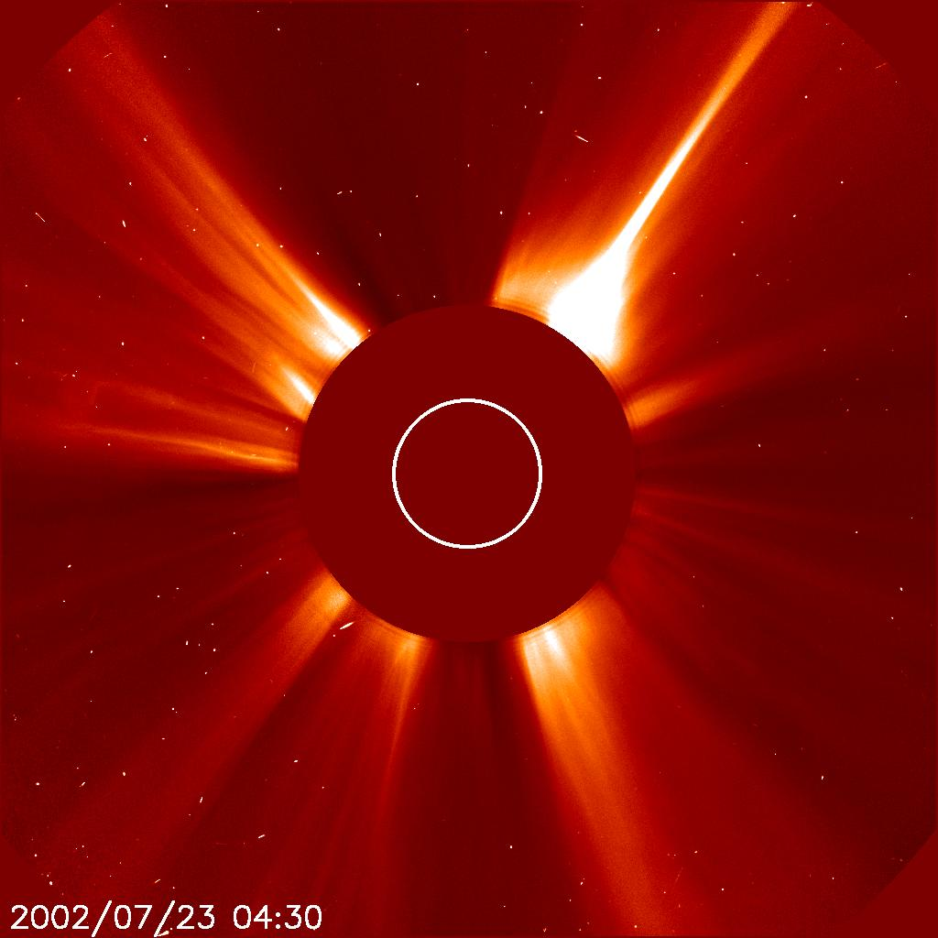

Slide 7
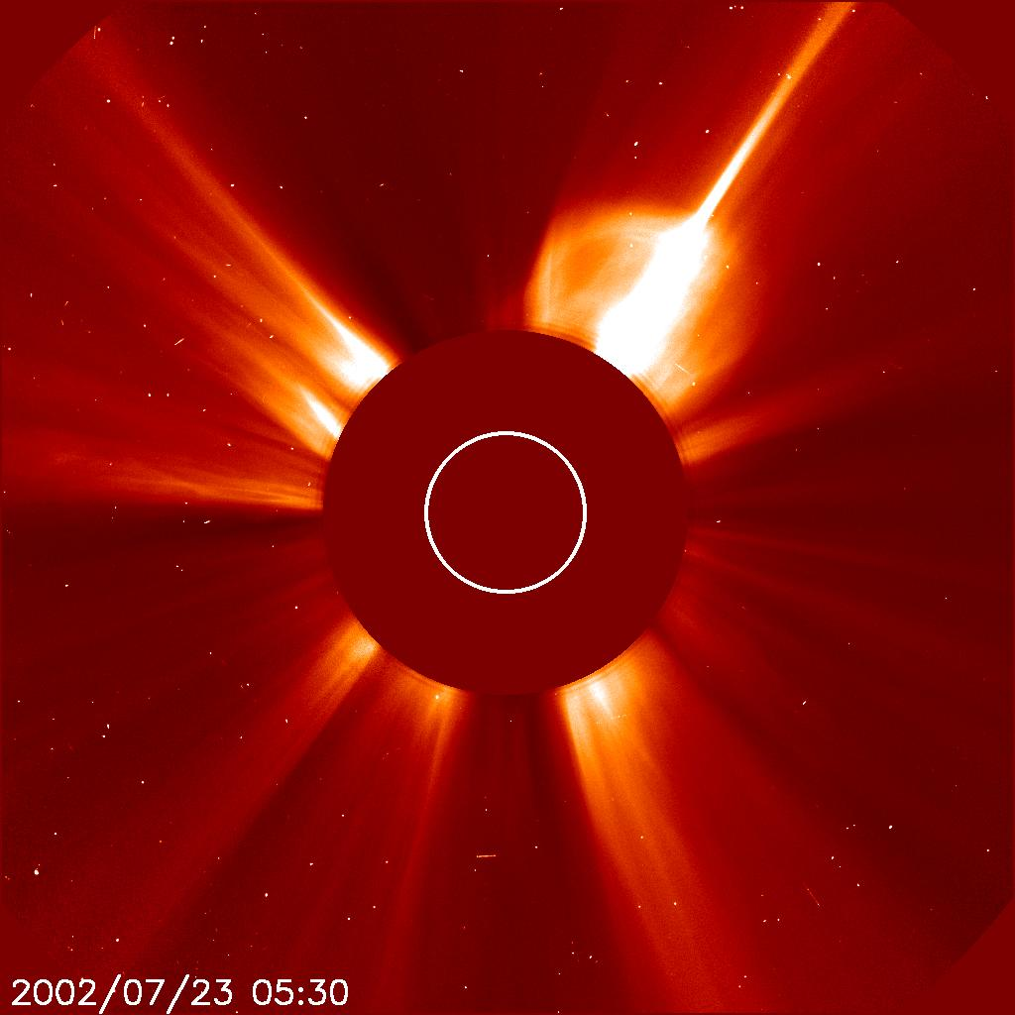

Slide 8
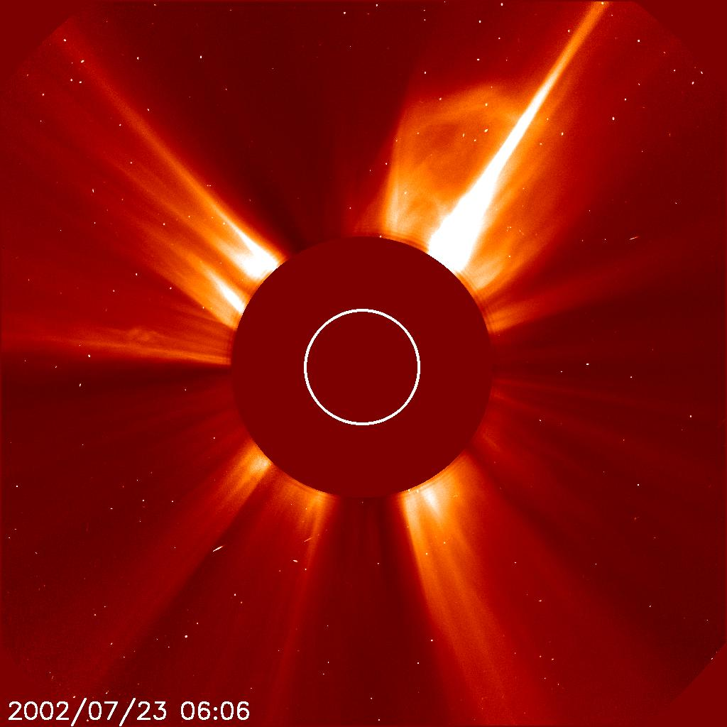

Slide 9
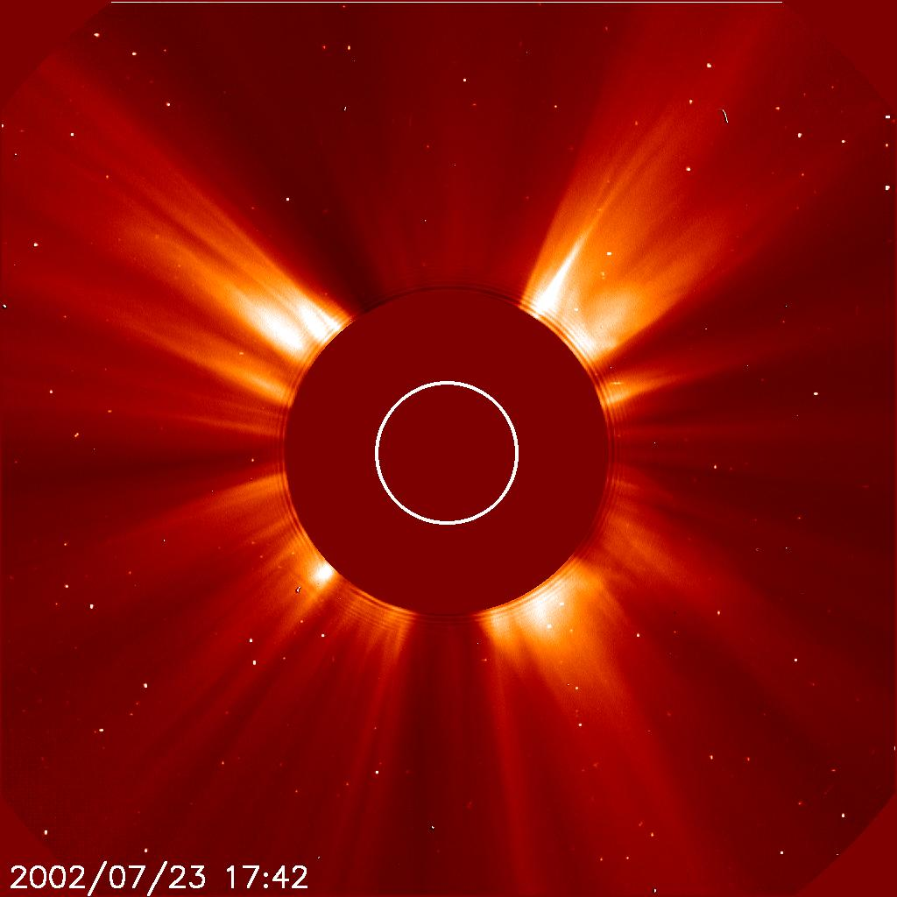

Slide 10
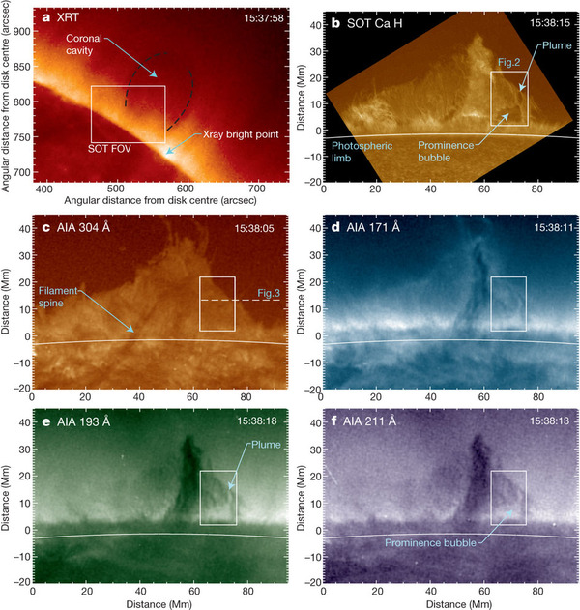
Prominence of
June 22 2010,
NW solar limb
(Berger et al. 2011)

Slide 11
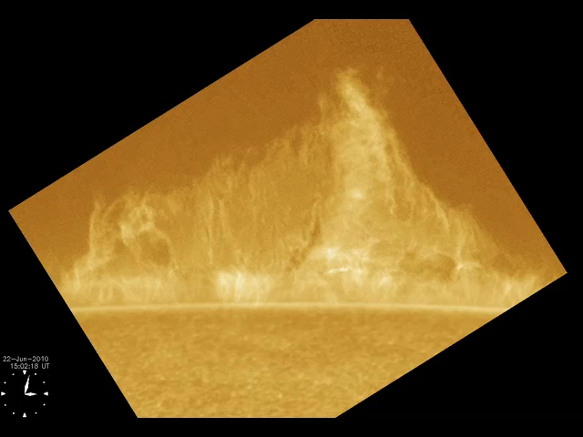

Slide 12
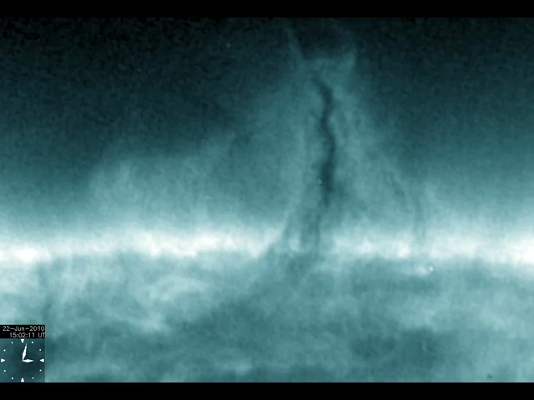

Slide 13
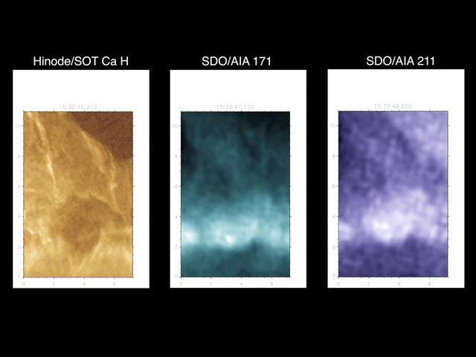

Slide 14
3 aspects of the prominence problem
The polar-crown quiescent prominence – constantly active filamentary structures; descending, cool, vertical threads and vertical lanes of bubbly rising, hot tenuous gas & macroscopic stability.
Must not forget the larger-scale coronal magnetic structure containing a quiescent prominence - the 3-part coronal helmet – dense dome, low-density cavity plus the quiescent prominence, as the magnetic origin of the 3-part CME.
What do the prominences do over a solar cycle? It is a marvel that the photosphere can reverse its global magnetic polarity in a matter of 2-3 years. It is an even greater marvel that the corona, a voluminous, almost perfect electrical conductor, can keep up in pace with the photospheric field reversal.

Slide 15
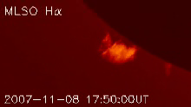
Macroscopic stability – the DeToma et al. (2008) event

Slide 16
3 aspects of the prominence problem
The polar-crown quiescent prominence – constantly active filamentary structures; descending, cool, vertical threads and vertical lanes of bubbly rising, hot tenuous gas & macroscopic stability.
Must not forget the larger-scale coronal magnetic structure containing a quiescent prominence - the 3-part coronal helmet – dense dome, low-density cavity plus the quiescent prominence, as the magnetic origin of the 3-part CME.
What do the prominences do over a solar cycle? It is a marvel that the photosphere can reverse its global magnetic polarity in a matter of 2-3 years. It is an even greater marvel that the corona, a voluminous, almost perfect electrical conductor, can keep up in pace with the photospheric field reversal.

Slide 17
Prominence drainage rate: “A prominence quasi-steady with a total mass of about 10¹⁴ g can have an order of magnitude more mass, 10¹⁵ g comparable to a CME mass, drain through in a day. The estimated drainage changes in time in proportion to the quasi-steady fluctuating total mass of the prominence in its range of 10¹⁴ g.” – SDO/AIA observations (Liu, Berger & Low 2012)

Slide 18
Quiescent prominence (i.e., the observed parts of it)

Slide 19
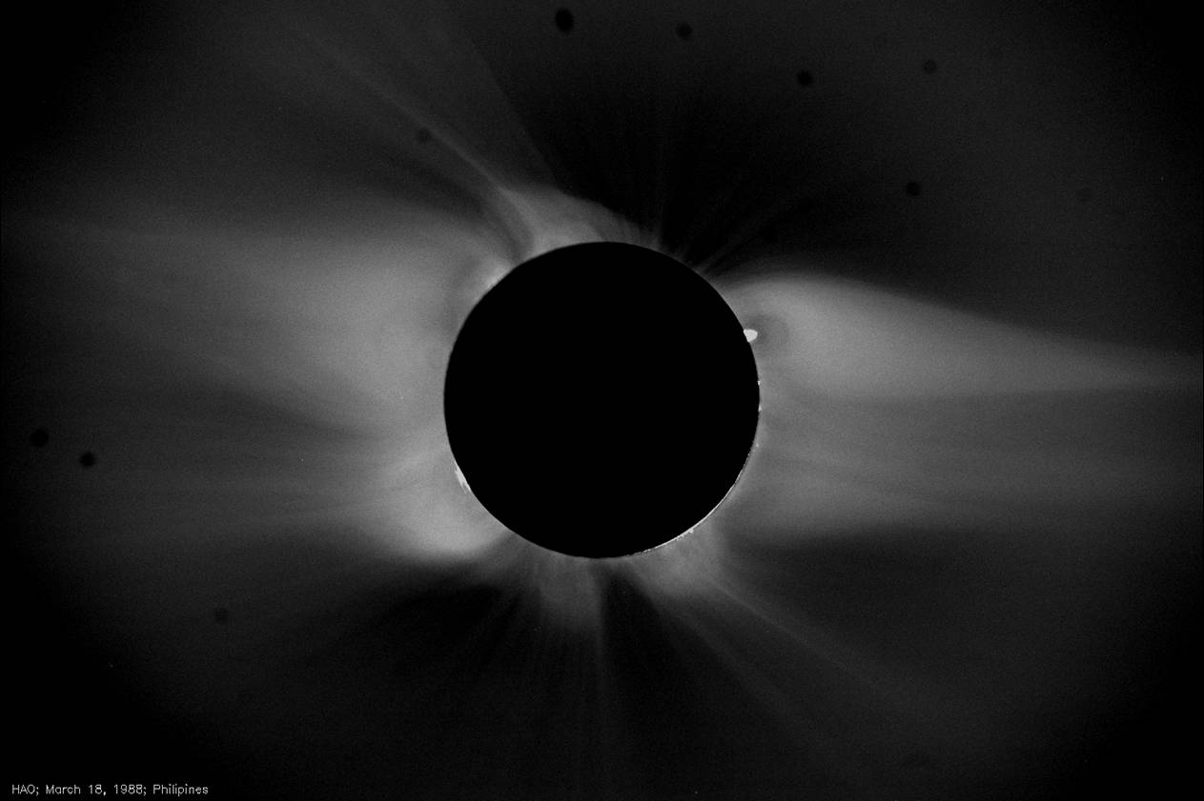
The 3-part coronal helmet streamer

Slide 20
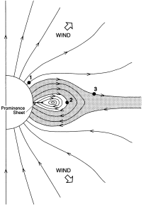
A flux-rope view of the helmet-streamer -Low & Hundhausen 1995, ApJ 443, 818

Slide 21
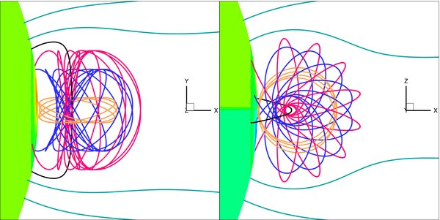
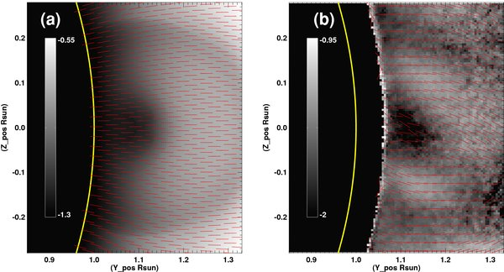
Coronal magnetic-field observations
-Tomczyk et al. 2008, Sol. Phys. 247, 411 Dove et al. 2011, ApJ 731, L1

Slide 22
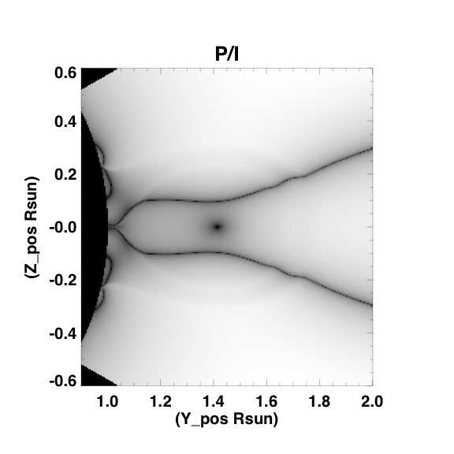
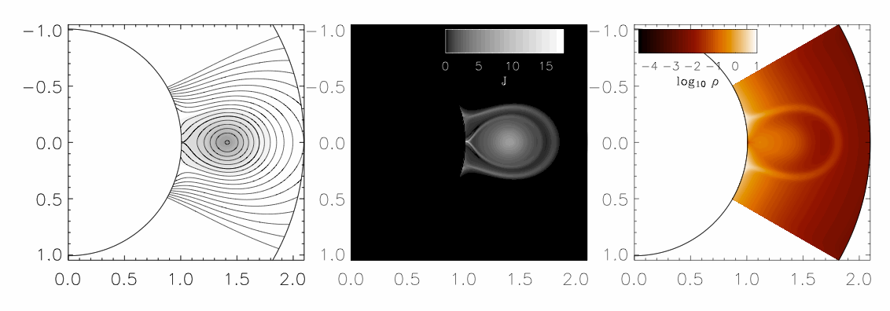
Cavity = Flux rope
Model B (POS)
Model P/I (POS)
Van Vleck inversion in flux rope
Van Vleck inversion in arcade
Flux rope axis
P/I
Observed cavity intensity (left) cavity polarization (middle) and flux rope model polarization (right)

Slide 23
A difficulty
From reasonable estimates of electrical conductivity in the prominence and corona, we expect a high degree of magnetic frozen-in condition, so it is troubling that the observed magnetic field in the cool plasma is largely horizontal.
One unattractive possibility is that the field in the cool plasma is vertical and the spectral-polarimetric observations are not valid.
An attractive possibility is that the cool and hot plasmas are moving bodily with their frozen-in magnetic flux.

Slide 24
An intriguing hypothesis: It is in the MHD nature of a very high degree of magnetic frozen-in condition to readily develop circumstances under which that condition must breakdown.

Slide 25
Not a hypothesis but an established property: It is in the nature of a compressible (neutral) fluid with a very small viscosity to develop in its flow thin layers of strong gradients within which the approximation of neglecting the viscosity must break down – the familiar hydrodynamic-shock phenomenon.

Slide 26
The corona as a hydromagnetic atmosphere
Tenuous, fully-ionized and hot, 10⁹ cm⁻³, 1.5x10⁶ K at base.
Highly anisotropic thermal conductor - excellent along but suppressed across the magnetic field.
Excellent electrical conductor – magnetic field is frozen into the plasma(?).
Magnetic field of about 10 G at base, low-β environment – field dominated (?).
Horizontal prominence fields – 5-60 G (Leroy, Casini, Lopez-Ariste)
Globally unconfined atmosphere – the solar wind.

Slide 27
The MHD equations describing the corona as a fluid atmosphere
“astronomical scales vs laboratory scales”
What you can’t see clearly can have macroscopic
or observable consequences!
Heating, radiative loss, thermal conduction.

Slide 28
The η=0 magnetohydrostatic atmosphere
“hydrostatic stratification”
“thermally highly-conducting plasma plus magnetic insulation”
The Kippenhahn-Schlüter 1D slab:
Let’s see how far we can go with η=0 before we get into trouble, if at all.

Slide 29
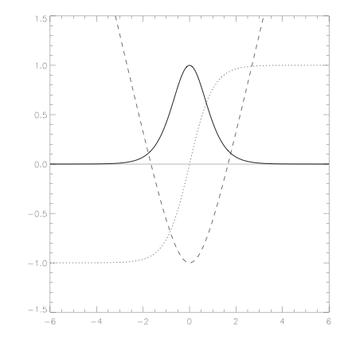
The isothermal KS-slab
field-line
ρ(y)
B_{z}=B₂H(y)

Slide 30
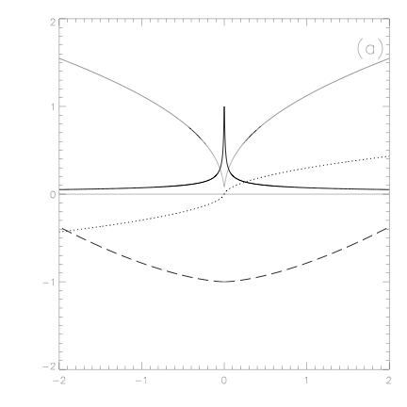
Thermally-balanced KS-slab
T(y)
ρ(y)
B_{z}=B₂H(y)
field-line

Slide 31
The η=0 crisis for the magnetohydrostatic atmosphere
“hydrostatic stratification”
properties of the fluid
“thermally highly-conducting plasma plus magnetic insulation”
B₁ & B₂ prescribe the part of field
The Kippenhahn-Schlüter 1D slab:
(H, R, B₁, B₂ ) fix the total mass!

Slide 32
What is the crisis? – The total mass per unit flux in the magnetic field should be a free parameter we can arbitrarily prescribe, so it cannot be fixed by fluid and magnetic field properties. We must conclude that not all the equilibrium states are accounted for by the everywhere continuous solutions. We need to admit discontinuous solutions.

Slide 33
The mathematics of nonlinear ordinary and partial differential equations
Physical laws are often expressed in terms of pdes under the natural assumption of continuous functions of space-time.
These laws are often also stated in the conservative forms, in which case integral equations are the natural expressions of these laws.
There are two kinds of singularities, ie, discontinuities of functions, that can arise in a pde description. One kind arises as a first approximation that neglect variations on some chosen small scales. If we actually look into structures of these and smaller scales, we can recover what we have neglected to resolve. Over such a structure, the integral description takes care of the physical laws.
More drastic are those singularities that come from not a neglect of spatial resolution but are intrinsic to the pdes. These are structures within which the physical laws embodied by the pde have nothing to say and yet they imply that such structures must be allowed, with the internal structures accounted for by additional physics. This kind of singularity is exemplified by the hydrodynamic shock.

Slide 34
Global vs local conditions
Heating must balance radiative loss globally – thermal conduction merely mediates.
Total columnar mass is crucial – hydrostatic stratification to ensure “proper” transport of excess heat to be dumped as radiation.
That global balance is too delicate to accomplish – either too much heat or too little.
The two heat-shielding effects – magnetic and columnar-mass shielding.

Slide 35
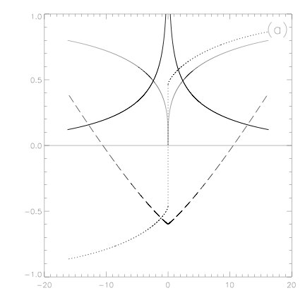
Thermally-balanced KS-slab with a collapsed core
δ(y)-function in ρ
T(y)
ρ(y)
field-line
B_{z}=B₂H(y)
τ=L²/η
δ(y)-function in current-density; perfectly admissible if η=0
but must dissipate resistively if η is small but non-zero

Slide 36
Consequences of breakdown of η=0
Under the η=0 approximation, thermal collapse sets in to produce cross-field flow with resistive heating.
Resistive heating raises the temperature to restore the η=0 approximation, and the process repeats intermittently.
Dynamical effects: lightened flux tubes rise vertically and overloaded flux tubes sink vertically, stretching the laden cool plasma into vertical threads.
Release of gravitational potential energy.

Slide 37
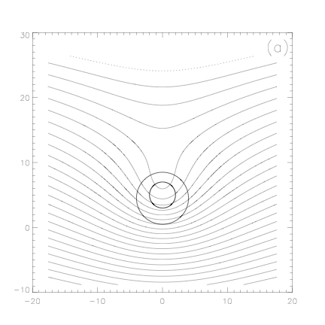
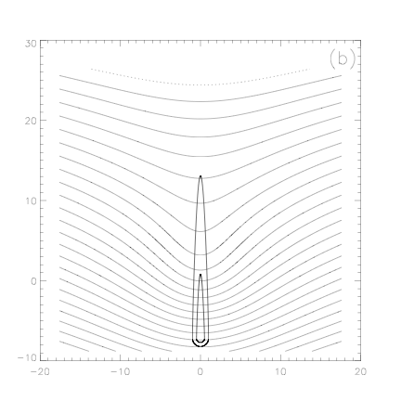
Buoyant rise, heavy sinking, & vertical threads
hot & frozen-in
cold & resistive

Slide 38
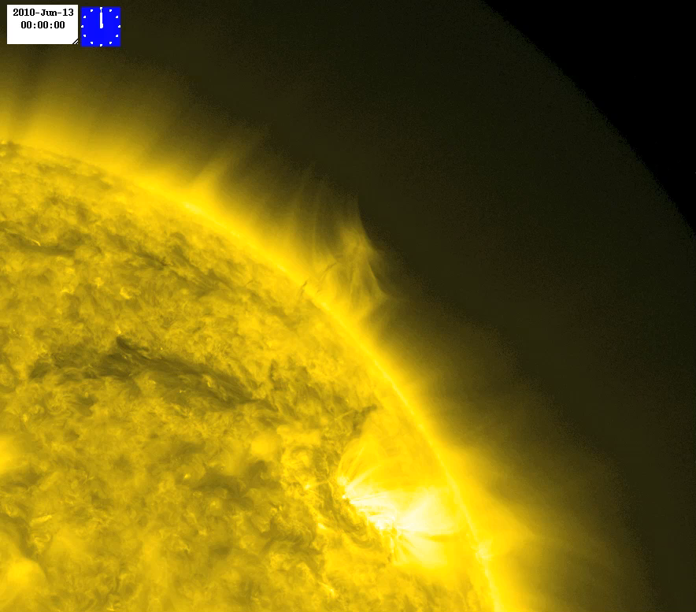
Prominence eruption, June 13, 2010

Slide 39
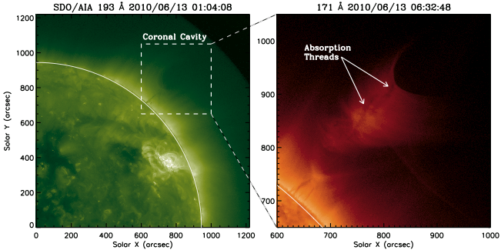
Prominence eruption, June 13, 2010

Slide 40
The isothermal KS-slab
field-line
ρ(y)
B_{z}=B₂H(y)

Slide 41
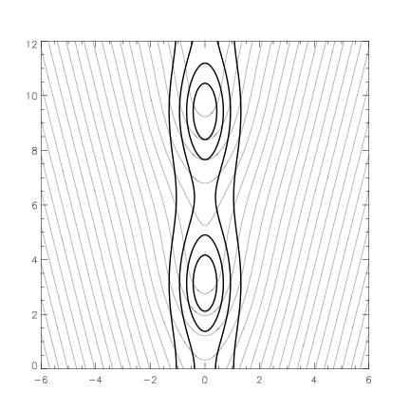
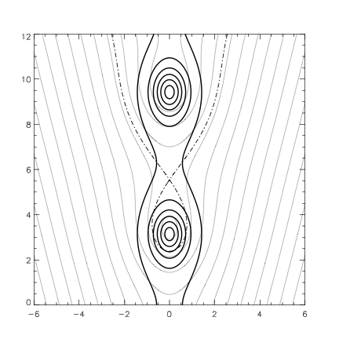
2D extension of the isothermal KS-slab
Suppressing cross-field thermal conduction has a far more drastic effect
of creating discrete currents “everywhere” – a multidimensional effect.

Slide 42
A snag …..which comes first, breakdown of frozen-in condition or the cross-field thermal insulation?

Slide 43
Closing remarks
The Parker theory of spontaneous current sheets, forming in consequence of the preservation of field topology under the frozen-in condition.
In the prominence environment, this process is the origin of the restless interior of a quiescent prominence, driven by thermal processes with the suppression of cross-field thermal conduction, in spite of β << 1.
This basic effect allows the prominence-cavity to “dislodge” plasma from field in order to re-organize its large-scale configuration – flux emergence is likely to be the driver of this “low-β convection”.

Slide 44
END

Slide 45
The other slides not used in the seminar

Slide 46
Three-part polar crown helmet
Figure 1 shows a polar-crown prominence as a one of the three parts of a coronal helmet, observed in scattered white-light, H-alpha, Fe XV. The EIT and MDI images that this conspicuous helmet structure is associated with weak fields on the solar surface, away from the strong-field active-region to its south. The two BBSO full-disk images shows that a week earlier, this prominence is more than a solar radius long across the solar disk.
The helmet dome and tenuous cavity are held by a closed, frozen-in magnetic field, each field-line anchored at two footpoints on the coronal base; simple bipolar field-lines in the dome and twisted field-lines in the cavity, depicted in Figure 2. The field external to the helmet is open, extending from the coronal base out into the solar wind.
The cavity at the helmet base is a magnetic flux system of complex topology, likely to be twisted and winding within the cavity. Figure 2 presents some possibilities involving a twisted flux rope in which locally U-shaped flux-tubes are naturally present. Polarimetric observations of coronal fields support this idea (Tomczyk et al. 2008, Dove et al. 2011).

Slide 47
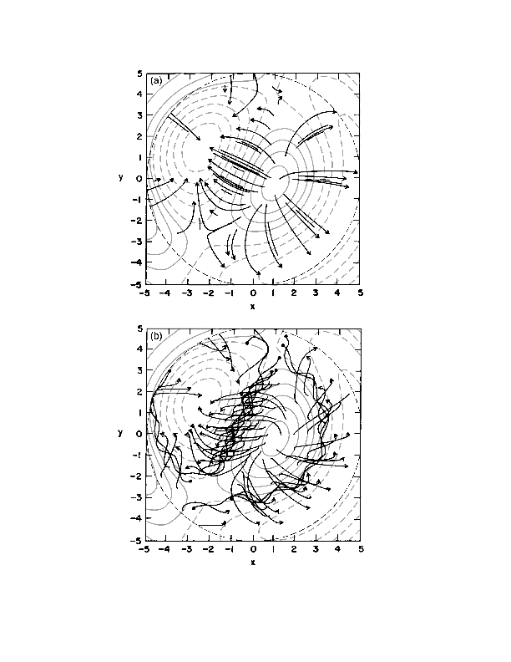
Figure 2. A theoretical view of the corona helmet
2b. 3D untwisted potential-field arcade
2c. 3D spheromak-type flux rope:
intertwined, simple bipolar blue flux- tubes;
multiple-turn bipolar white flux-tubes;
levitating, U-shaped flux-tubes filled
with red prominence fluid.
Lites & Low 1997, Solar Phys. 174, 91.
flux-rope
2a. idealized axisymmetric 3-part helmet
-Low & Hundhausen 1995, ApJ 443, 818
2c. 3D twisted flux-rope in sheared-field arcade

Slide 48
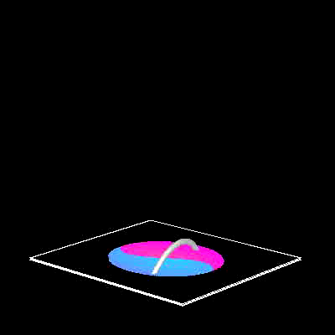
Figure 2. A theoretical view of the helmet-streamer
2b. 3D untwisted potential-field arcade
2c. 3D spheromak-type flux rope:
intertwined, simple bipolar blue flux- tubes,
multiple-turn bipolar white flux-tubes,
levitating, U-shaped flux-tubes filled
with red prominence fluid.
Lites & Low 1997, Solar Phys. 174, 91.
2a. idealized axisymmetric 3-part helmet
-Low & Hundhausen 1995, ApJ 443, 818
2c. 3D twisted flux-rope in sheared-field arcade

Slide 49
The dynamic prominence interior
What constrains the descending threads and rising bubbles to move at approximately constant, below free-fall speeds in the range of 5-30 km/s identified by Hinode SOT in Figure 3 (Berger et al. 2008, ApJ 676 L89; 2010, ApJ 716, 1288)? SDO/AIA confirmed that the tenuous rising bubbles are hot at (2.5-12) 10⁵ K.
Spectral-polarimetric observations give prominence magnetic-fields of 5-60G, typically horizontal (Lopez Ariste & Casini 2003, ApJ 582, L51). Gravitational acceleration can thus be annulled by the Lorentz force, but SDO suggests that the descending dense threads can drain away the mass of a CME (10¹⁵ g) in a day (Liu, Berger & Low 2012, see abstract below). How is all this to be reconciled with the usual frozen-in condition of high electrical conductivity?

Slide 50
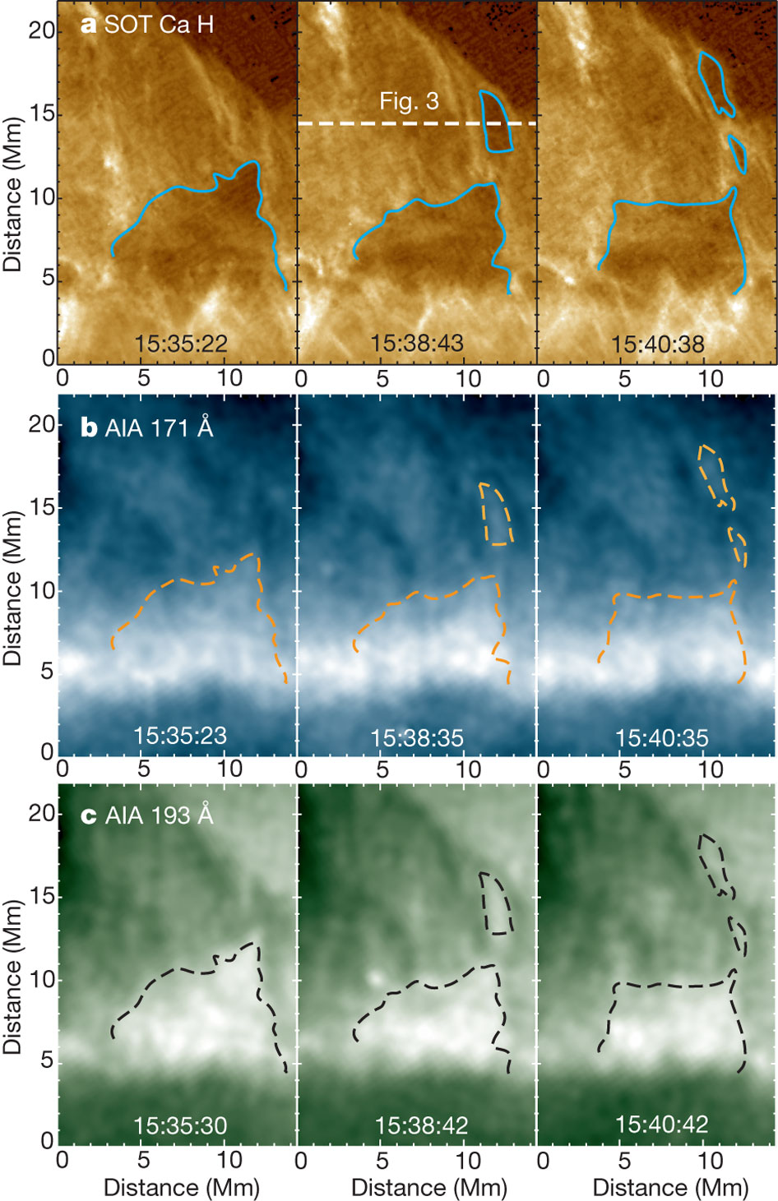

SDO/AIA observations of prominence bubble and plumes
Time series of images taken during the large plume generation event in the prominence observed on 22 June 2010.
hot plume breaking off
quasi-steady hot bubble
T Berger et al. Nature 472, 197-200 (2011) doi:10.1038/nature09925

Slide 51
SDO/AIA shows that an order of magnitude more mass ~10¹⁵ g may drain in a day down a moderate-sized prominence maintained quasi-steadily at total mass ~10¹⁴ g. Does this drainage involve a breakdown of frozen-in condition?

Slide 52
A theoretical problem on the coupling between force-balance & steady energy-transport
constant gravity
hydrostatic stratification along flux tubes
heating
optically-thin radiation
field-aligned thermal conduction

Slide 53
Figure 4. The 1D thermally-balanced Kippenhahn-Schlüter prominence slab
constants
force-balance
energy-transport
Constants describing fluid properties
Ideal gas law
thermal
boundary conditions

Slide 54
Nature of the everywhere continuous thermally-balanced slab of a moderate total mass M; with radiative loss α₀ ρ² T
Excess heat is thermally conducted along the bow-shaped field from the far hot regions
to be radiated away by the dense central region of the slab. The temperature gradient is
zero at Y=0, not resolved at the scale of the graph, that is, the inward thermal fluxes are
exactly depleted upon arriving at Y=0. This is a delicate arrangement!

Slide 55
Nature of the discontinuous thermally-balanced slab of an excessive total mass M; with radiative loss α₀ ρ² T
δ-function in density
discontinuity in B_{z,} implying δ-function in current density
With too much total mass M, a self-consistent pair of inward thermal fluxes along the
bow-shaped field would have been depleted by the dominating radiative loss before Y=0
is reached, so that the core of the slab would cool to zero temperature, manifesting in
the inevitable δ-function distributions in fluid and current densities in the equilibrium state.

Slide 56
A few statements on thermal collapse
There are 2 heat insulation mechanisms. The magnetic field is an insulator in its perpendicular direction. The fluid is self-insulating by its gravitational stratification, too much columnar mass along the field shutting out the conductive coronal heat. So, is there so much mass in the prominence for this effect to be important?
The mathematical model shows that under the frozen-in condition, force-balance and steady energy transport cannot generally both be met without a fraction of the frozen-in mass collapsing into a δ-function mass sheet, within which its discrete current must dissipate resistively. Thus, the frozen-in condition creates such extreme circumstances under which it breaks down. Are the observed descending thin dense threads in the prominence interior such a resistive flow? See Low, Berger, Casini & Liu (2012) for the ramification of such a possibility.
Perhaps canonical numbers like 5,000K and particle densities of the order of 10¹¹ cm⁻³ are only properties of the observed optically-thin parts of prominences. Fluids of much higher densities, much lower degrees of ionization and temperatures than we conventionally contemplate may exist in the prominence.

Slide 57
The Parker (1994) spontaneous current-sheets
The 1D Kippenhahn-Schlüter slab is made up of identical bowed flux tubes. The model serves to show self-collapse without the complication of force-balance among flux-tubes.
In 2D and 3 D fields, especially of complex topologies such as considered by van Ballegooijen & Cranmer (2010), tube interaction leads to current-sheet formation. Each flux tube rapidly equilibrates to meet hydrostatic and thermal-balance requirements along the field, on the one hand, and cross-field balance of the Lorentz force, on the other. Each tube is thermally insulated from the adjacent tubes, so that the thermal structures of adjacent tubes are uncorrelated. Thus the fluid pressure is generally discontinuous across magnetic flux surfaces. In the low plasma β environment, the field readily takes up the stress with compensating discontinuous jumps in magnetic pressure. Magnetic tangential discontinuities thus form which must dissipate resistively in spite of the small but nonzero resistivity. Is this Parker process applied to prominences relevant to the massive prominence drainage observed by SDO/AIA as reported by Liu, Berger & Low (2012)?
The Parker current-sheet process under prominence condition is treated by Low, Liu, Berger & Casini (2012).

Slide 58
2D magnetostatic prominence, just to show how intractable the problem can get to be …..
Heated, radiating, thermally-conducting model:
Isothermal model:
cross-field force-balance
hydrostatic force-balance
along field
mass-loading function
thermal flux
thermal-balance
ideal gas law

Slide 59
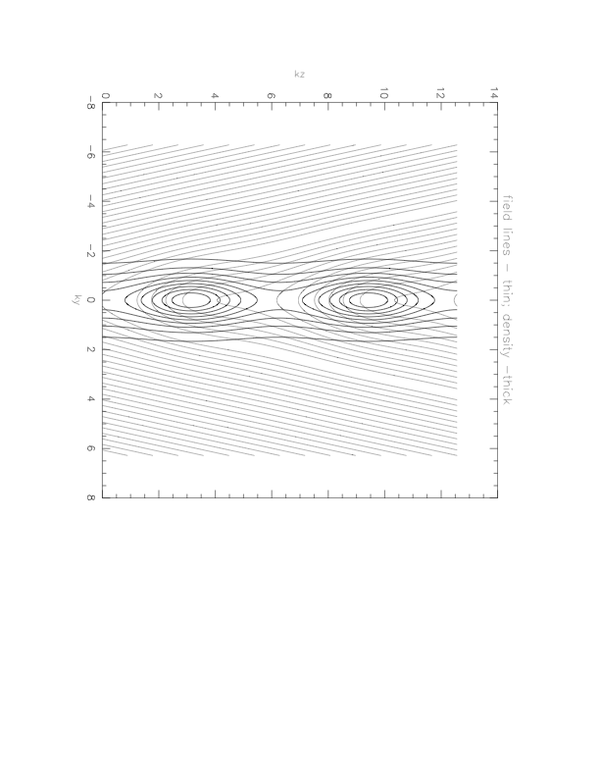
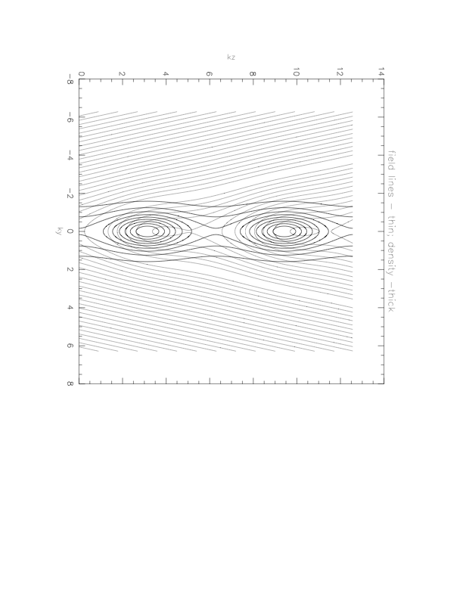
Break-up of Kippenhahn-Schluter slab to 2D vertically periodic isothermal slab, each period containing the same total mass distributed around two maxima.
magnetic bubble of thermally completely isolated plasma
necking into a bubble creating totally
different thermal structures along
adjacent flux tubes
All field-lines are U-shaped.
U-shaped field-lines with magnetic bubbles.

Slide 60
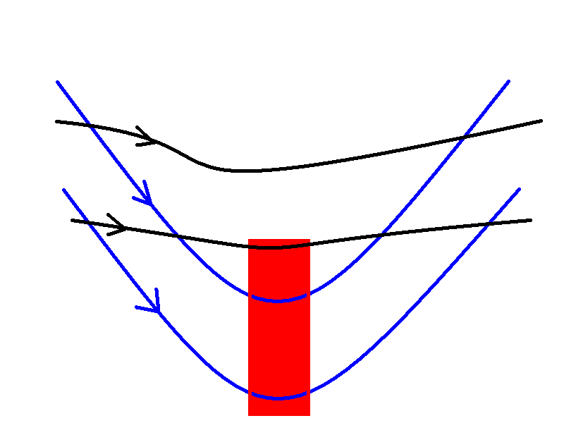
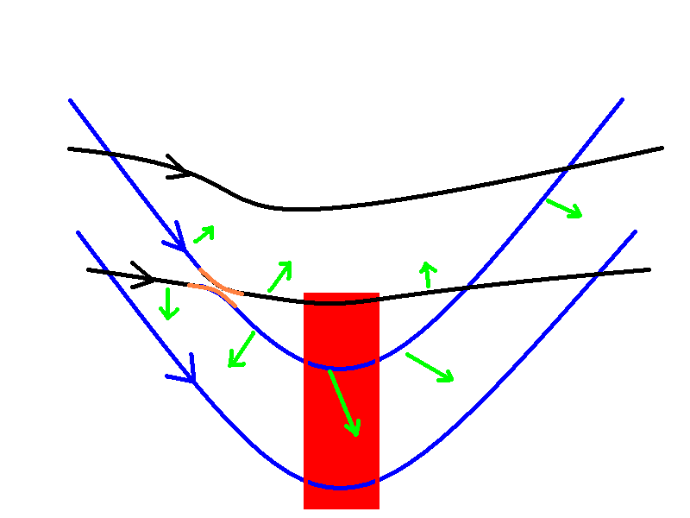
A Reconnection Sequence Petrie & Low (2005)

Slide 61
The Berger et al. (2011) proposal and intriguing questions
Emerging magnetic flux drives a constant cycling of mass from the chromosphere, in the form of heated, tenuous hot plasma, up into the coronal cavity overlying a quiescent prominence. This up-flow leaves the magnetic flux behind in the cavity and returns as the draining vertical threads, essentially establishing a novel form of ’magneto-thermal’ convection in the solar outer atmosphere.
Is the helmet cavity a flux rope? If it is, does it grow in size to eruption by this convection? Are the observed lanes of bubbly hot tenuous fluids and macroscopic bubbles and plumes actually magnetic flux systems continually added to the cavity? Is this how magnetic helicity accumulates in the corona as described in Zhang & Low (2005)? We need polarimetric field measurements!
Can observations show that enough mass exists in the cavity to condense to chromospheric and even lower temperatures, resulting in thermal collapse and current-sheet formation, as an explanation of the impressive mass drainage observed in prominences?
If these ideas are valid, we are a step closer to interpreting the 3-part coronal helmet from slow evolution to CME eruption in terms of specific physical processes.
This is the progress and excitement Hinode and SDO have delivered to prominence study, much still to be figured and sorted out.

Slide 62
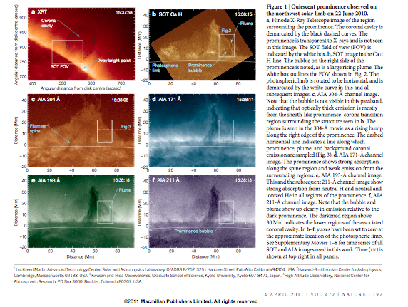

Slide 63
SDO/AIA observations of prominence bubble and plumes
Time series of images taken during the large plume generation event in the prominence observed on 22 June 2010.
hot plume breaking off
quasi-steady hot bubble
T Berger et al. Nature 472, 197-200 (2011) doi:10.1038/nature09925

Slide 64
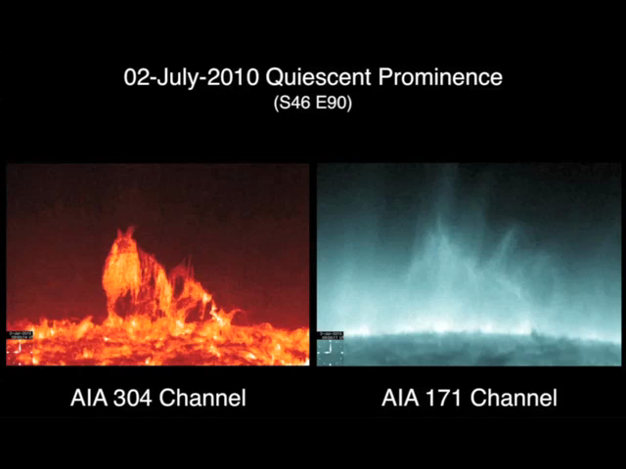

Slide 65
Some References
Dove, J. B., S. E. Gibson, L. A. Rachmeler, S. Tomczyk, P. Judge 2011, ApJL 731, L1
Low, B. C., T. Berger, R. Casini & W. Liu, 2011, ”The Hydromagnetic Interior of a Solar Quiescent Prominence. I. Coupling between Force-Balance and Steady Energy-Transport”, submitted, ApJ (http://arxiv.org/abs/1203.1056)
Low, B. C., W. Liu, T. Berger & R. Casini 2011, ”The Hydromagnetic Interior of a Solar Quiescent Prominence. II. Hydromagnetic Discontinuities and Cross-Field Mass Transport.” , preprint
Tomczyk, S., G. L. Card et al. 2008, Solar Phys. 247,
van Ballegooijen, A. A., & S. R. Cranmer 2010, ApJ 711, 164
Zhang, M., & B. C. Low 2005, ARAA 43, 103

Slide 66
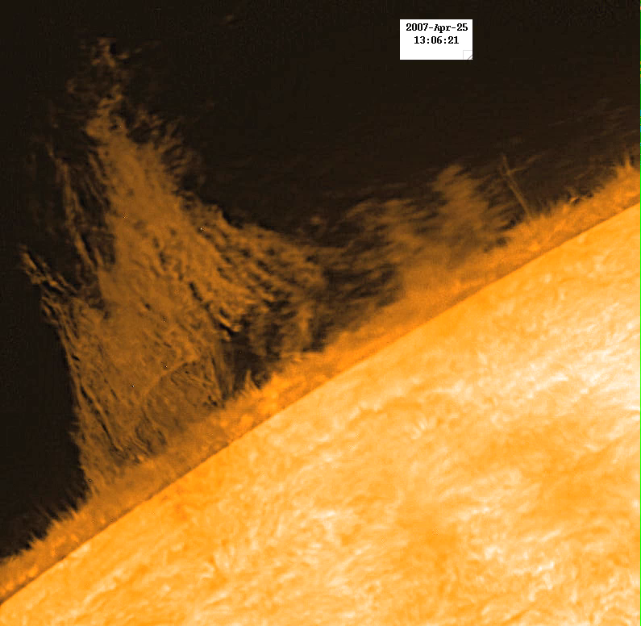
Hinode SOT 25, 2007 H_alpha Movie

Slide 67
Figure 3. Descending vertical dense, cool threads & narrow lanes of bubbly, rising, hot tenuous fluids (Berger et al. Berger et al. 2008, ApJ 676 L89; 2010, ApJ 716, 1288; 2011, Nature 472, 197)
3a. segmented, descending
vertical threads of
cool & dense fluid
3b. bubbly, rising,
hot & tenuous fluid
3c. slowly evolving
hot & tenuous fluid-
perhaps an emerged
magnetic flux system

Slide 68
Hinode SOT 25, 2007 H_alpha Movie
What field configuration?
What is it doing?

Slide 69
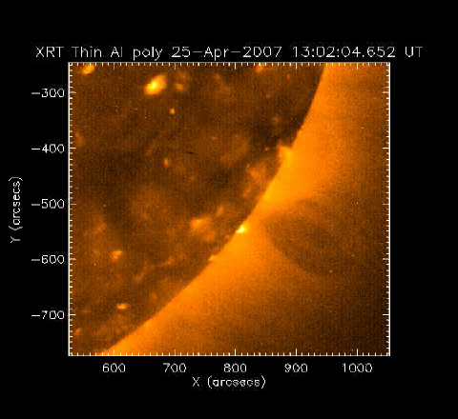
The Cavity of the April 25, 2007 Hinode Prominence

Slide 70
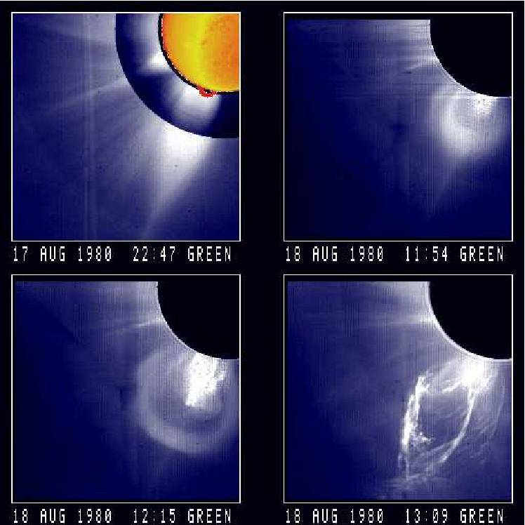
August 17, 1980 CME

Slide 71
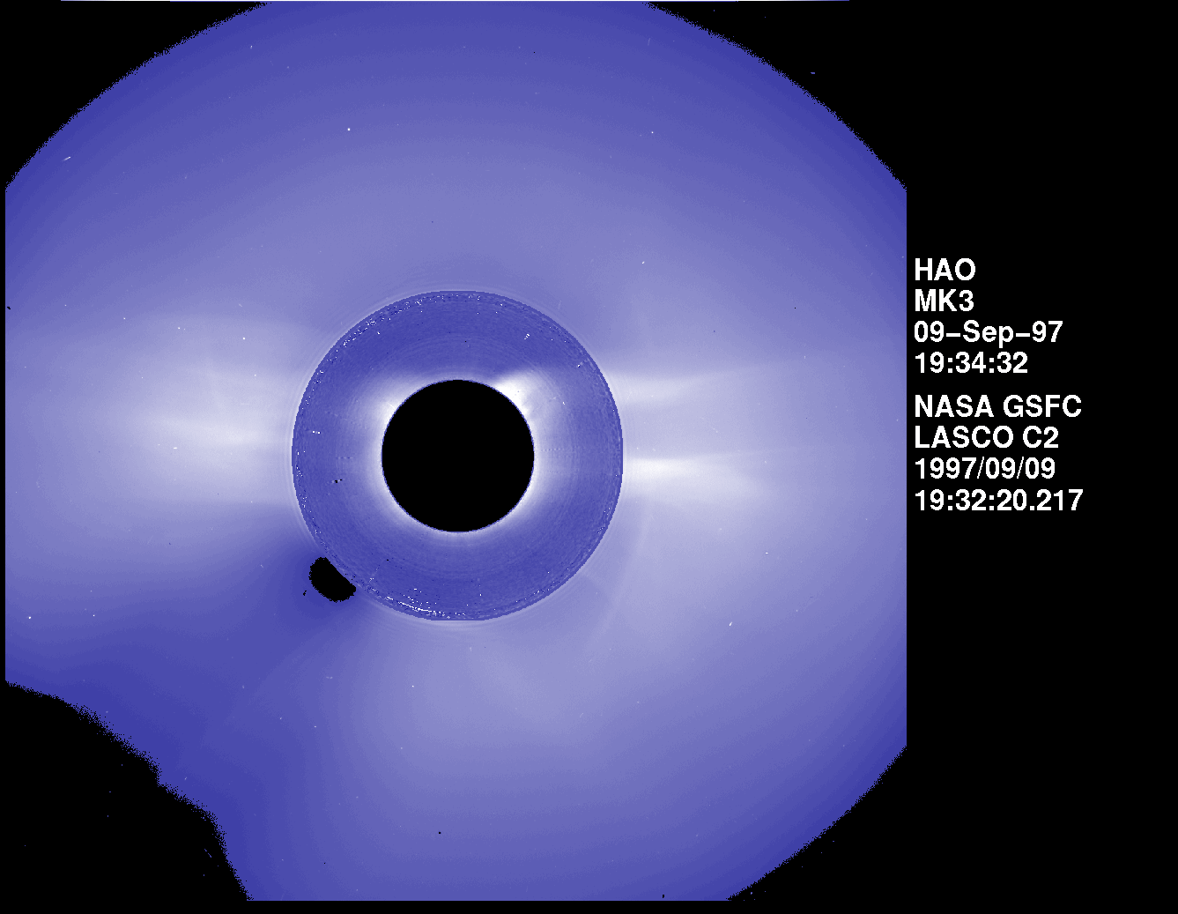
September 9, 1997 CME

Slide 72
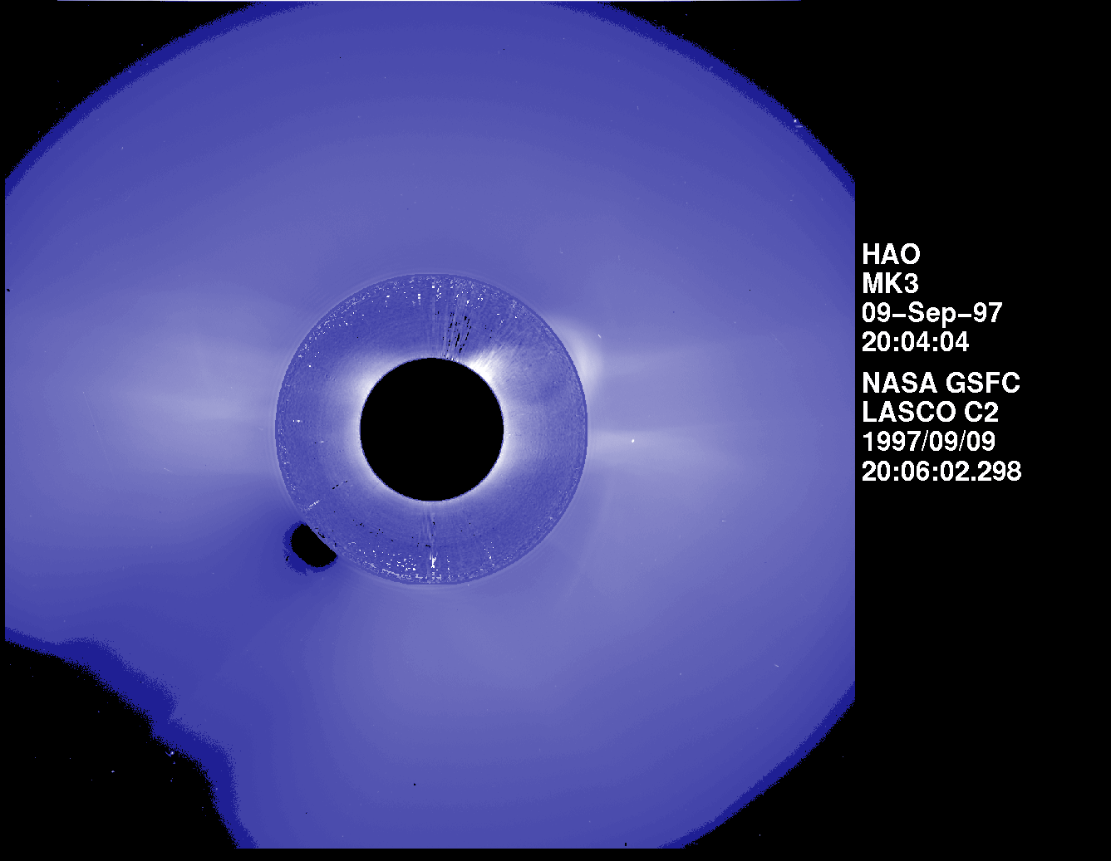

Slide 73
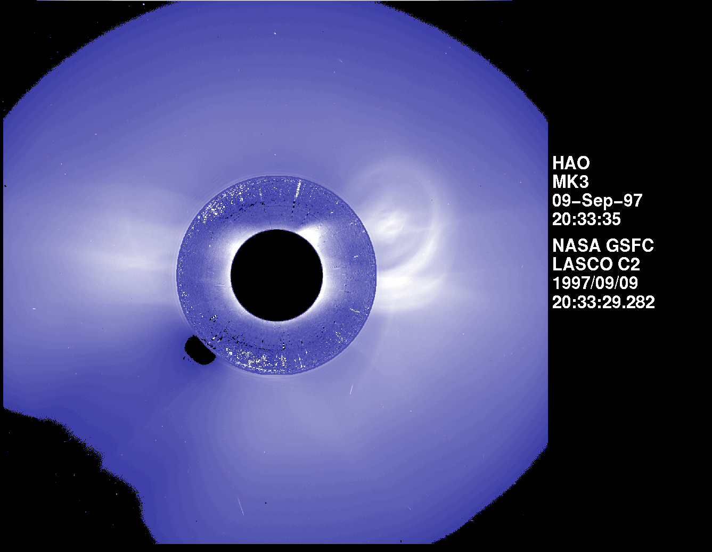

Slide 74
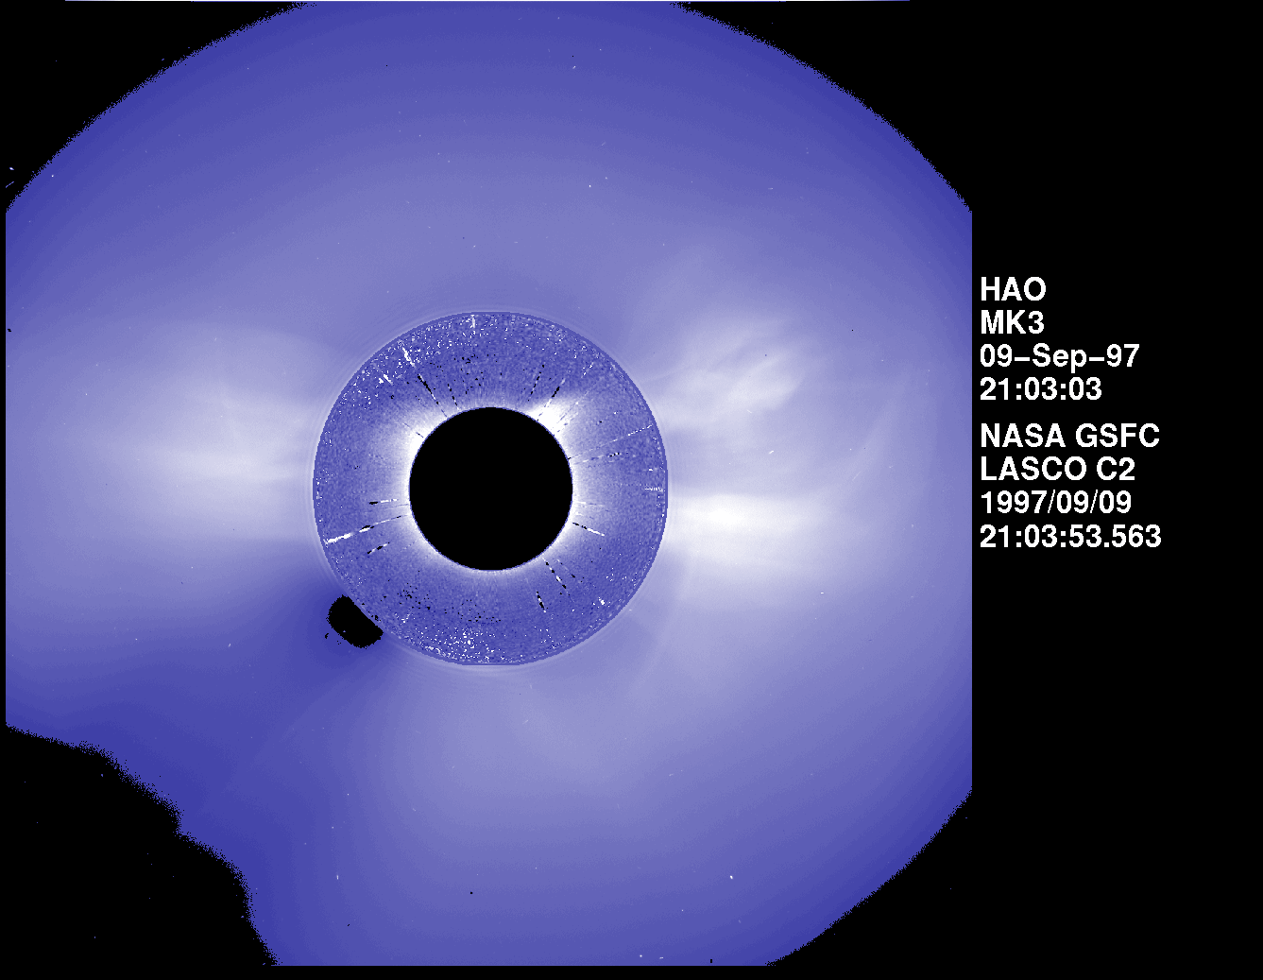

Slide 75
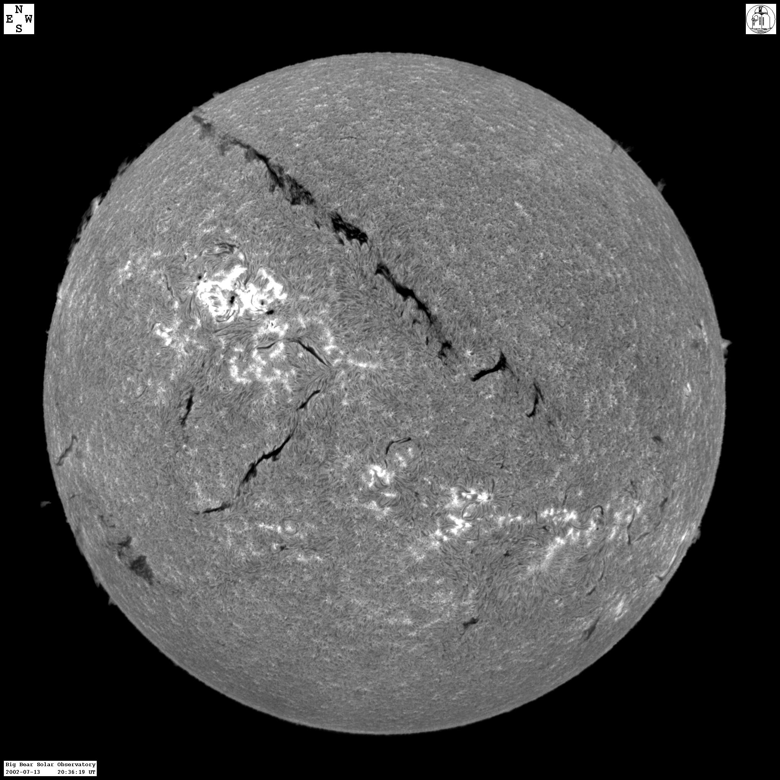
Full-disk H-alpha images
Big Bear Solar Observatory
H_alpha fulldisk

Slide 77
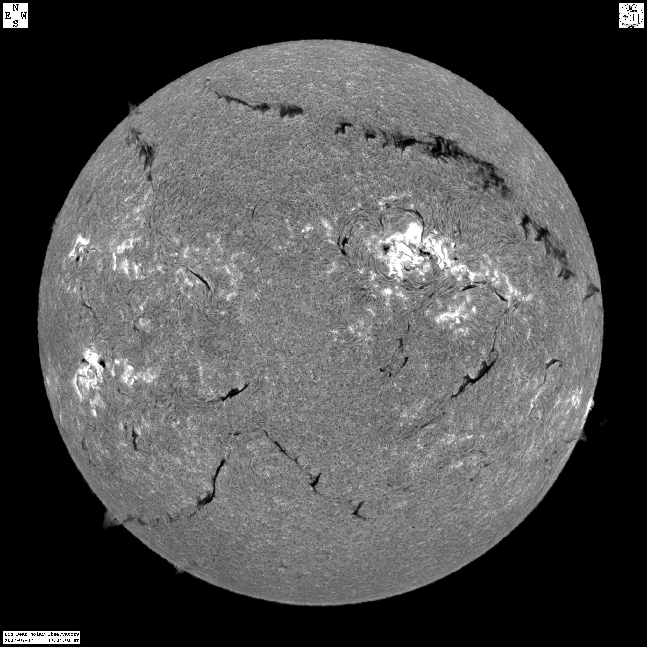

Slide 78


Slide 79


Slide 81


